Slide 1

Time series data analysis and forecast methods
Lecture 8
Time series forecast with autoregressive models

Slide 2

Lecture map
Basic forecast from ARMA model
Example of retrospective forecast with AR model
Correction method for ARMA models based on new observations
Example of corrections with new observations
Estimation of confidence intervals for forecast
Example of confidence interval reconstruction for an ARMA model forecast

Slide 3
part 1. forecast with ARMA and ARIMA models

Slide 4
Forecast with ARIMA model
ARIMA (p, d, q) models can be reduced to ARMA (p+d, q) stationary models.
In these models there are a relationship between current and previous observations, thus making the ARMA models the perfect way to forecast time series data.

Slide 5
Forecast with ARMA model
The main principle to create the forecast scheme with ARMA model – to minimize the forecast mean-square error (MSE);

Slide 6
Forecast with ARMA model
ARMA model can be represented in three forms:
with difference equations;
with Wold theorem, ARMA = MA(∞);
with infinite weighted sum of previous observations;
All of these forms are equivalent to each other.

Slide 7
Difference equations
Future observations are denoted as , when we start the forecast at time point t with lead l.

Slide 8
Infinite sum of MA
Here the weighting coefficients can be calculated from characteristic polynomial:

Slide 9
Infinite sum of previous observations
Overall scheme is similar to the weighting scheme of the infinite MA with the inverse of characteristic polynomial.

Slide 10
Forecast estimation
Let’s try to estimate the best forecast:
Estimate the forecast MSE:
and its minimum must be when weighs are equal.

Slide 11
Forecast estimation
With minimization we will achieve:
First sum is an error, second sum is the
Then the best forecast function is:

Slide 12
Some implications
The forecast error is:
The error mean and variance are:
One-step error is:

Slide 13
Three forms of the forecast
Difference Equations:
Weighed Mean:
Integrated Forecast:

Slide 14
Part 2. Example of the forecast with AR model

Slide 15
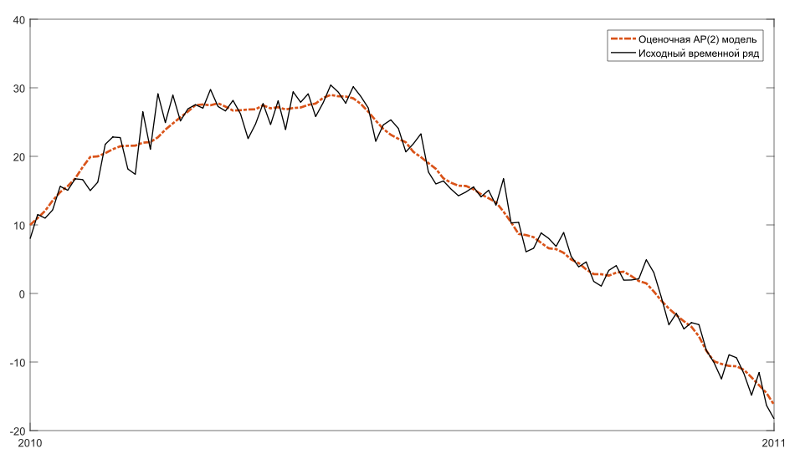

Slide 16
AR(2) model forecast
Let the time series data have a good approximation with AR(2) model;
We want to forecast it from the time point t;
We will use the difference equations form;

Slide 17
AR(2) model forecast
Forecast is built recurrently:
For the first point:
For the second point:
For the third and next points:

Slide 18
AR(2) model forecast
Forecast final scheme

Slide 19
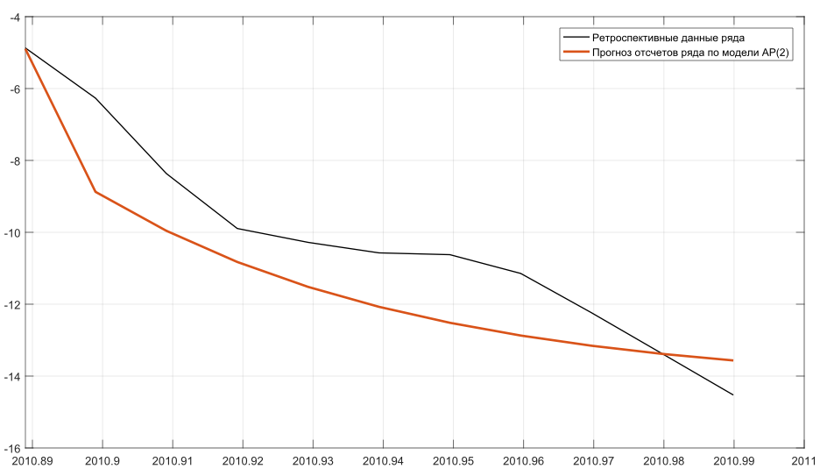

Slide 20
Part 3. Forecast correction with new observations

Slide 21
Weighting coefficients estimation
In order to find the confidence interval and to correct the forecast, we need to calculate the weighting coefficients

Slide 22
Weighting coefficients estimation
These coefficients can be found recursively:

Slide 23
Forecast correction scheme
To correct the forecast with every one new observation, we need to estimate the new weighting coefficients,
and then to find the new forecast point:

Slide 24
Forecast correction scheme
Simple recurrent scheme:

Slide 25
Correction example
Our AR(2) model:
The correction weighting coefficients:

Slide 26
Correction example
We received a new observation data point;
Let’s correct our AR(2) forecast as follows:

Slide 27
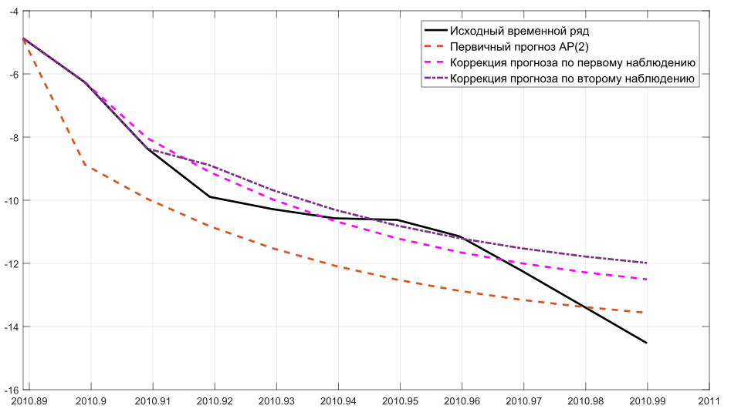

Slide 28
Part 4. Estimation of the confidence interval for forecast

Slide 29
Confidence Interval
Any forecast is not absolutely accurate, thus, there is always a probability, that the forecasted observation will deviate from the best estimation;
In order to find the borders of these deviations with the specified probability, the confidence interval is built.

Slide 30
Confidence Interval
Let’s find the variance of the forecast error:
We lack the parameter
But it can be estimated from residual data

Slide 31
Confidence Interval
The residual data is an error of fit between real data and constructed model;
If the model is constructed with optimal measures, then the error of fit must have a normal distribution;

Slide 32
Confidence Interval
The confidence interval:
where – quantile of level
for a standard normal distribution.
For 50%-bound quantile is –0,674;
For 95%-bound quantile is –1,96;
All of these values are in statistical tables.

Slide 33
AR(2) example
Confidence interval with 50% bound:

Slide 34
AR(2) example
Confidence interval with 95% bound :

Slide 35
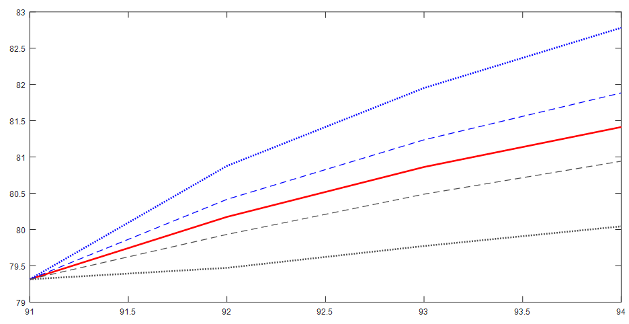

Slide 36
References
Box G., Jenkins G. Time Series Analysis: Forecasting and Control. — 4th ed. Wiley. — 2008. — 784 p.
Karter J. Time series analysis with MATLAB. ARIMA/VARMAX/GARCH/GJR Models. Functions and Examples. — 2016. — 422 p. ISBN 978-1-539-54638-2.
Chris Chatfield. Time-Series Forecasting. — Chapman and Hall/CRC; 1st ed. — 2000. — 280 p. ISBN 978-1584880639

